Slide 1
Boeing Autonomous Driving
By:
Elise Chantegros, Selina Cozens, Jacob Keeland,
Marek Lemieux, Desirae Mangum, Natasa Peric

Slide 2


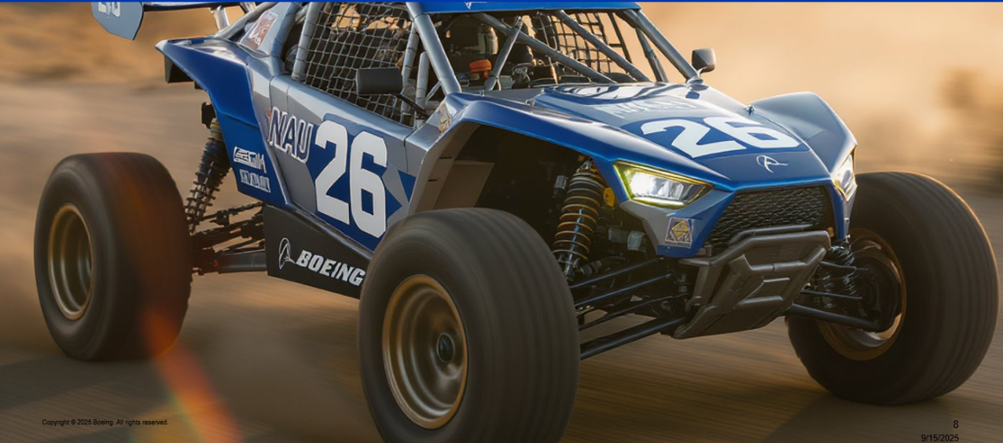
Project Description
Control system to Automate Traditional Vehicles
Brakes
Steering
Throttle
Sponsors and Stakeholders
Boeing (Michael Vogelsang)
Technical Support (Conner N. and Donald G.)
Importance
Future Transportation
Advanced Automation Technology
AI Generated Photo of Autonomous NAU Buggy provided by Boeing
SC 2

Slide 3
Brake Requirements
Customer Requirements​
Automatic Navigation without User Control in safe environments
The vehicle must be capable of safely navigating a pre-determined path and braking when necessary ​
Obstacle Detection and Subsequent Braking Response ​
The vehicle must overcome static and dynamic obstacles within its path and make subsequent braking or steering ​
Manual Override ​
The device must have a manual override system that allows the user to take control of the vehicle
State Monitoring
The vehicle must provide real time feedback on its status including battery life, current speed, and applicable live video to a user interface
Killswitch that has Easy Access for User ​
The vehicle must have an emergency stop button that immediately cuts power and brings the vehicle to a stop ​
JK 3

Slide 4
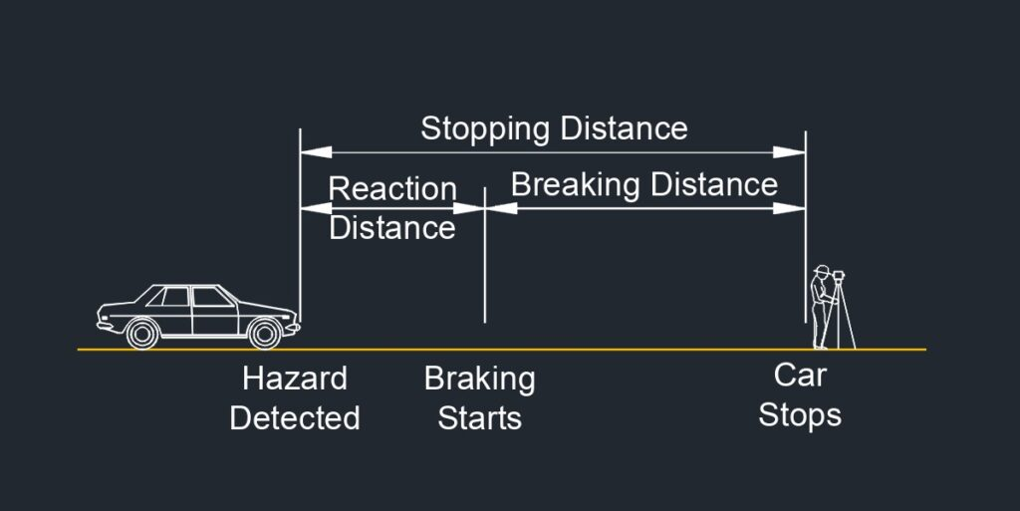
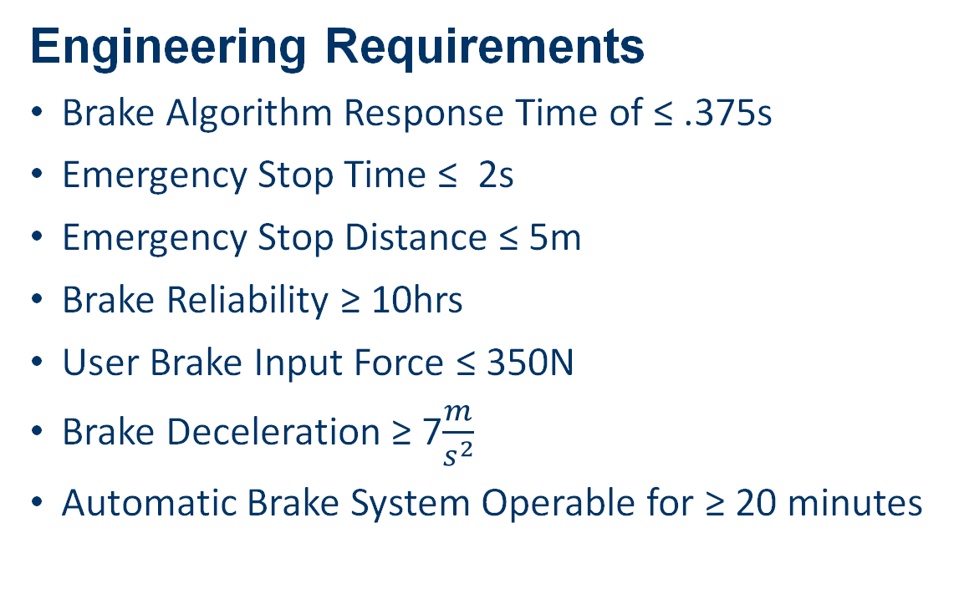
Brake Requirements
Engineering Requirements
Brake Algorithm Response Time of ≤ .375s
Emergency Stop Time ≤ 2s
Emergency Stop Distance ≤ 5m
Brake Reliability ≥ 10hrs
User Brake Input Force ≤ 350N
Brake Deceleration ≥ 7$\frac{m}{s^{2}}$
Automatic Brake System Operable for ≥ 20 minutes
Braking Diagram [1]
JK 4

Slide 5
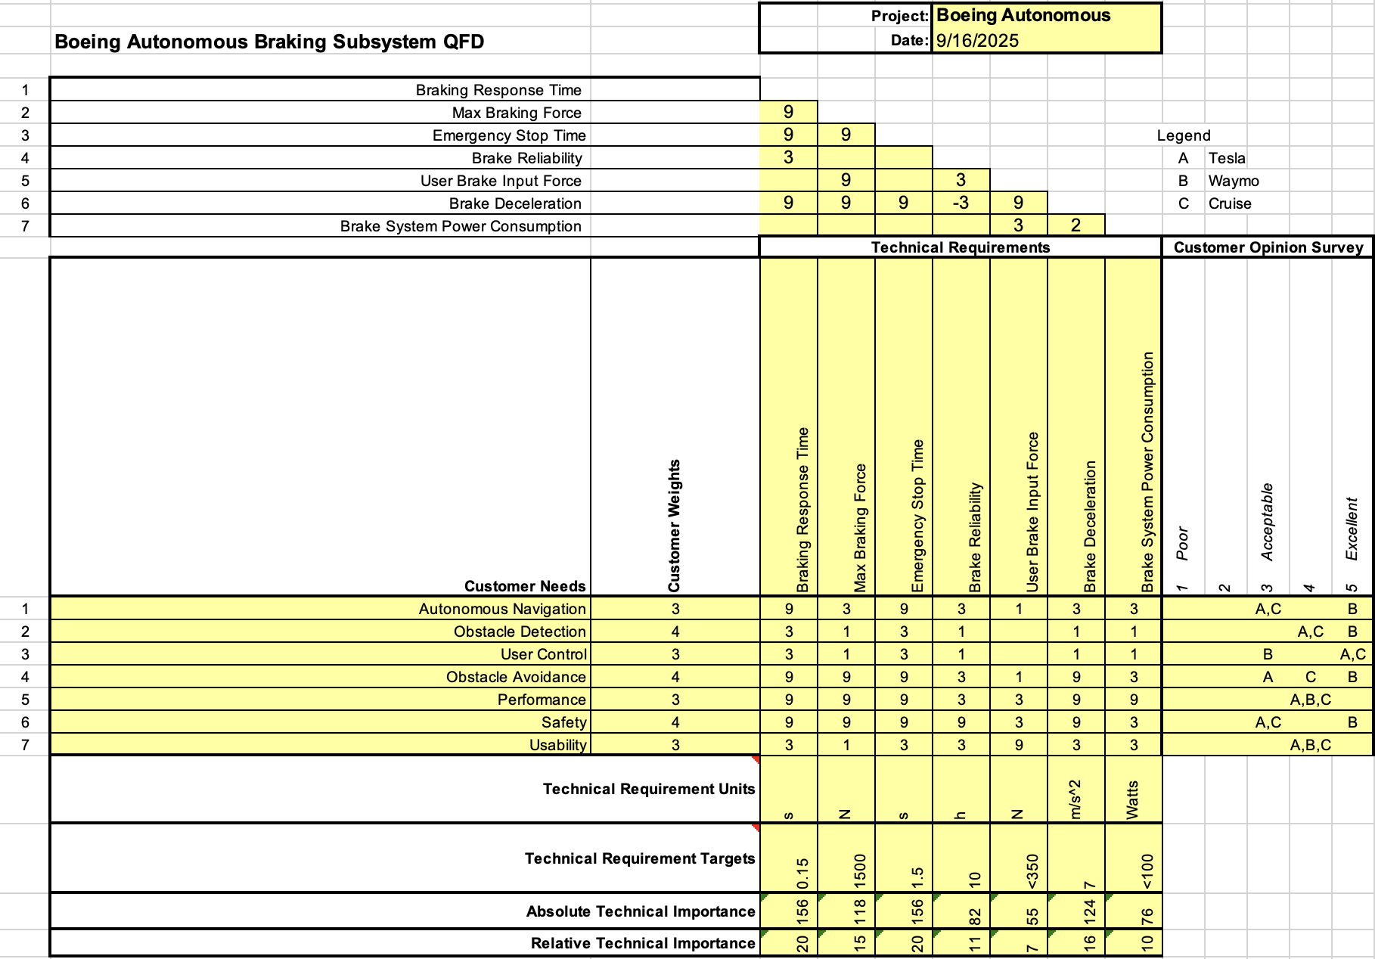
QFD – Brakes
JK 5

Slide 6
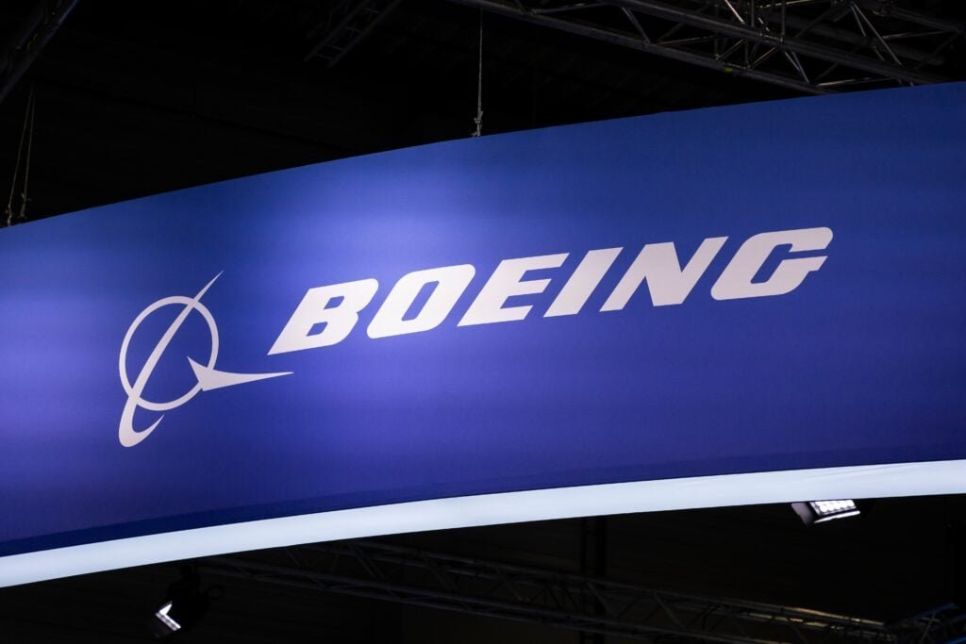
Steering Requirements
Customer Requirements
Autonomous Navigation
Obstacle Detection
User Control
Obstacle Avoidance
Performance
Safety
Usability
Boeing Logo Picture [2]
DM 6

Slide 7
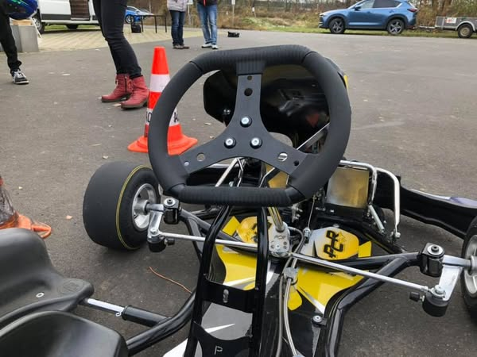
Steering Requirements
Engineering Requirements
Response time (< 500ms)
Wheel Rebound Velocity (5kph)
Max Rotation Range (900°)
Minimum Autonomous Torque (2.5Nm)
Minimum User Torque (2Nm)
Max Autonomous Turning Velocity (10kph)
Max Autonomous Turning Acceleration (15kph)
Go Kart Steering Wheel [3]
SC 7

Slide 8
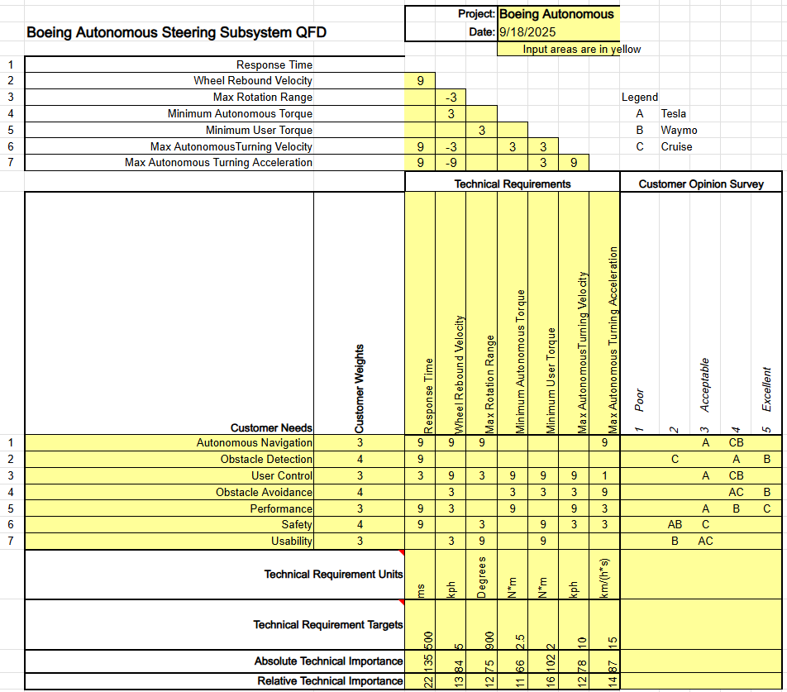
QFD - Steering
SC 8

Slide 9
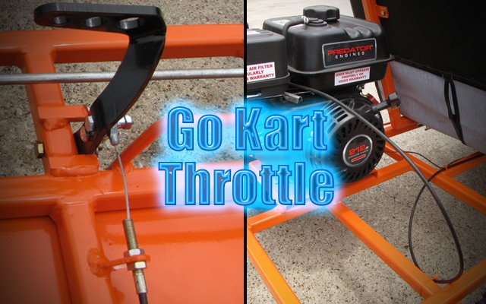
Throttle Requirements
Customer Requirements
Autonomous Navigation
User Control/Manual Override
State Monitoring/Diagnostics
Performance
Safety
Usability
Go Kart Throttle Picture [4]
EC/NP 9

Slide 10
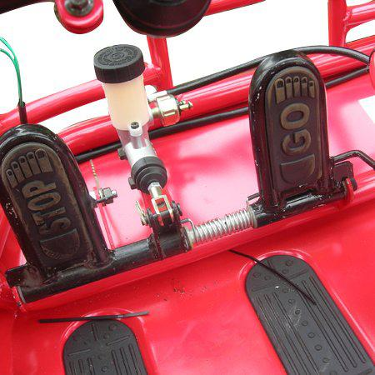
Throttle Requirements
Engineering Requirements
Response Time (<500ms)
Max Autonomous Speed (15kph)
Air Flow Rate (<30 CFM)
Max Pedal Force (~2.5N)
Min Actuator Response Time (50 ms)
Throttle System Power Consumption (≤ 100W)
Min User Override Force (10N)
Go Kart Throttle & Brakes [5]
EC/NP 10

Slide 11
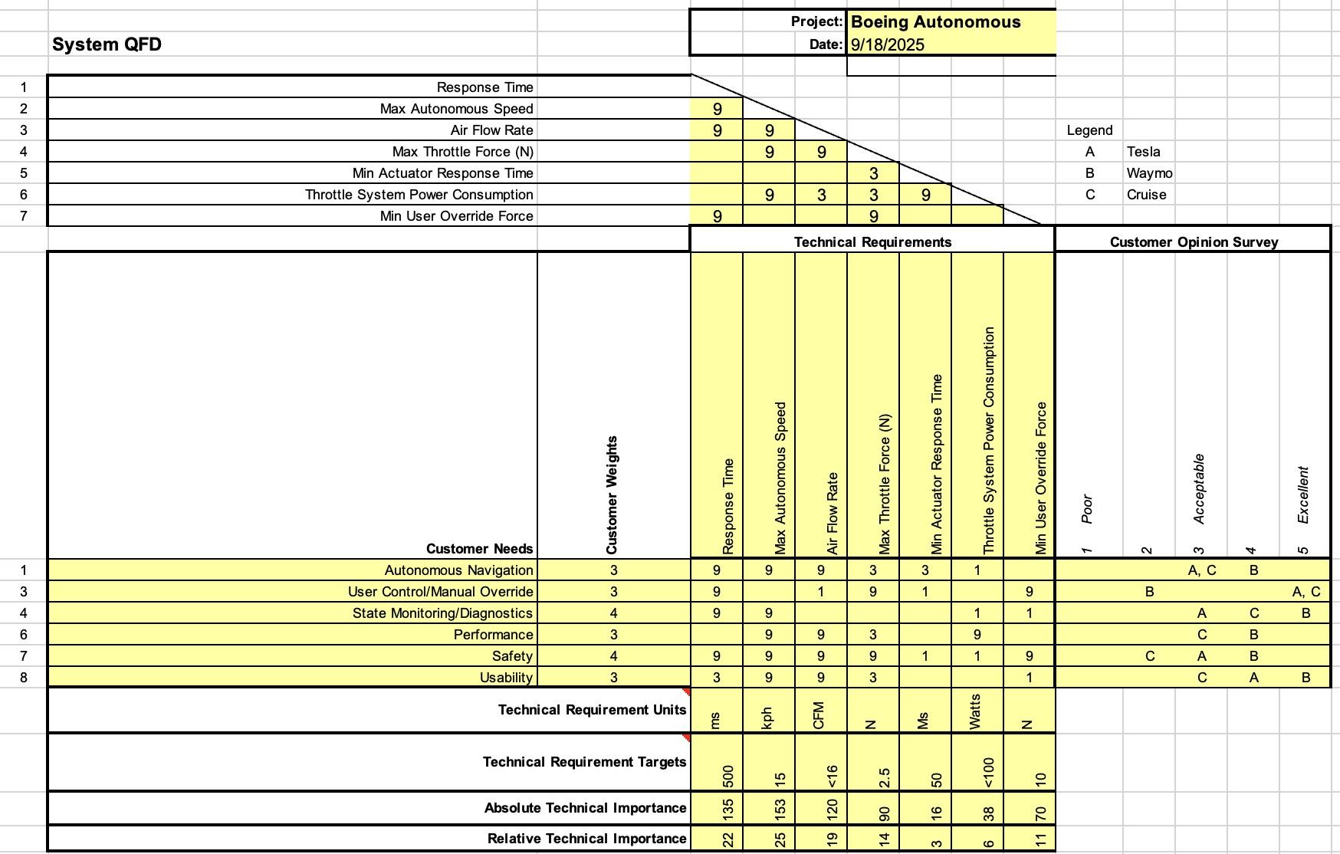
QFD - Throttle
EC/NP 11

Slide 12
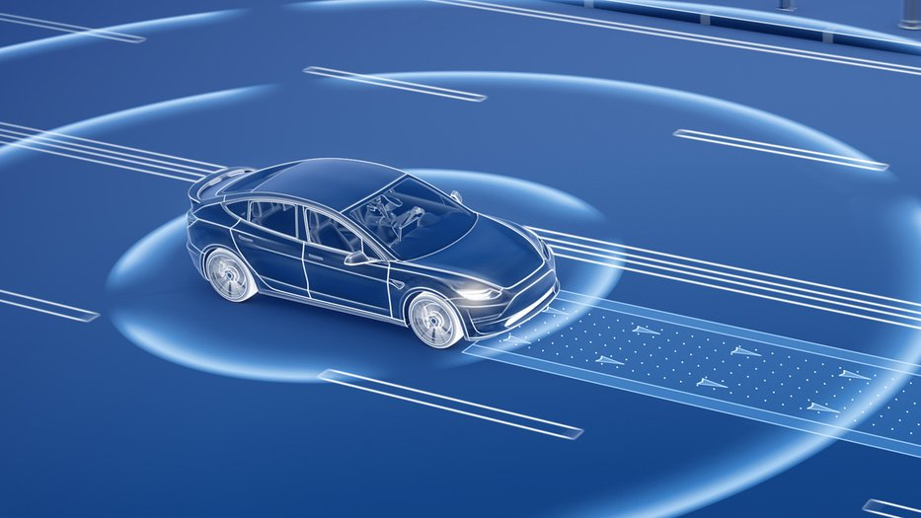
Background
Issues
Undetected Collisions
Poor Response Technology
High Cost
Possible Resolutions
Multiple Test of Systems
Effective Schedule
Cheaper Alternative to Competitors
Car with Autonomous Sensors [6]
DM 12
Notes:
Test and build off of current products on the market
building an actuation system for traditional cars can also be cheaper than owning a tesla or using waymo regularly

Slide 13
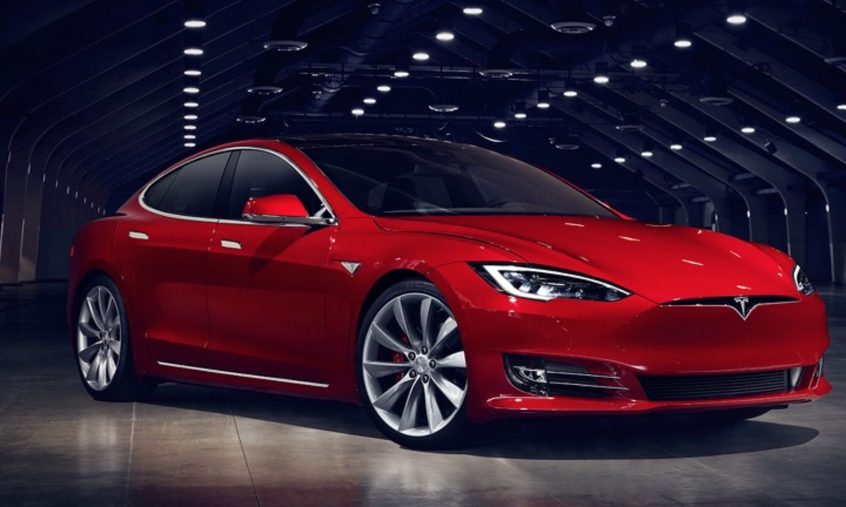
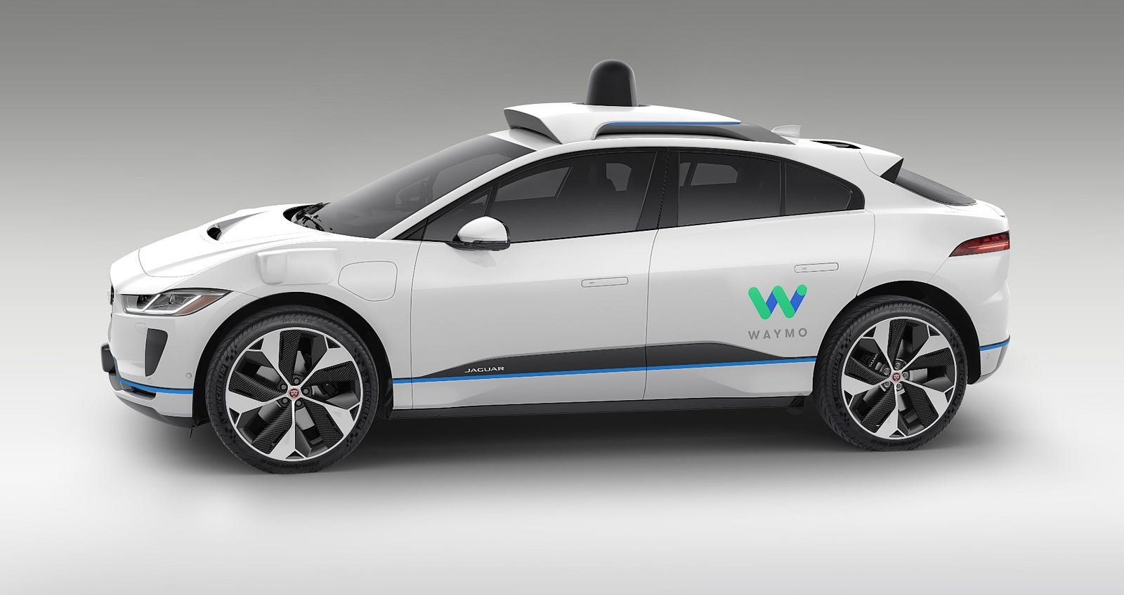
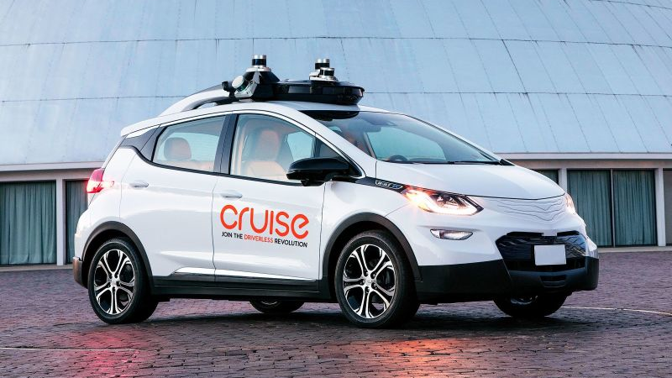
Benchmarking
Tesla:
Cameras
Pros: 1.2 megapixels
Cons: Depth perception
Waymo:
LiDAR
Pros: 30cm-3mm
Cons: >200m
Cruise:
LiDAR
Pros: 30cm-3mm
Cons: >200m
Tesla [7]
Waymo [8]
Cruise [9]
DM 13

Slide 14
Literature Review – Brakes
Vehicle Braking, Stability and Control on JSTOR [10]
Braking in different weather conditions
A hypothesis for the function of braking forces during running turns – ScienceDirect [11]
Force analysis from braking during turns
The Effect of Tire Break-In on Force and Moment Properties on JSTOR [12]
Adjusted braking values to compensate for wear
Analysis of heat conduction in a disk brake system | Heat and Mass Transfer [13]
Heat analysis of a disk brake to determine wear and heat generated
On the Distribution of Braking Forces in Road Braking on JSTOR [14]
Road based force calculations and simulations
Acceleration-Deceleration Behavior of Various Vehicle Types – ScienceDirect [15]
Deceleration analysis of vehicles
Autonomous Vehicles Testing and Operating in the State of Arizona [16]
Local laws for Arizona on autonomous driving vehicles including testing on public roads
ML 14

Slide 15
Literature Review – Brakes
Autonomous cars: Past, present and future—a review of the developments in the last century, the present scenario and the expected future of autonomous vehicle technology [17]
Bimbraw’s paper reviews the history, current state, and future prospects of autonomous vehicle technology, highlighting key developments and challenges over the last century
Fundamentals of Vehicle Dynamics [18]
Stopping under resistive forces
A study on the stopping time of a vehicle using the braking force distribution [19]
The website "Braking Physics" by David I. A. Cohen provides an in-depth, physics-based analysis of vehicle braking systems, including detailed calculations for stopping distance and time
Braking physics [20]
Equations and processes surrounding braking physics
A Case Study of Reaction Time Reduction of Vehicle Brake System – SAE Mobilus [21]
Analyzes methods to reduce brake system reaction time for faster and safer vehicle response
Regenerative Braking Control Strategy Based on AI Algorithm to Improve Driving Comfort of Autonomous Vehicles – MDPI Applied Sciences [22]
Develops an AI-based control strategy for regenerative braking that enhances both energy recovery and driving comfort in autonomous vehicles
Effects of Brake Actuator Error on Vehicle Dynamics and Stability – SAE Mobilus [23]
Investigates how brake actuator errors influence overall vehicle dynamics and stability during operation
JK 15

Slide 16
Literature Review - Steering
Reinventing the Wheel: Transforming Steering Wheel Systems for Autonomous Vehicles [24]
Modification for physical/visual alerts using a mechanical steering wheel and a LED steering wheel
Nonlinear Steering Wheel Angle Control Using Self-Aligning Torque with Torque and Angle Sensors for Electrical Power Steering of Lateral Control System in Autonomous Vehicles [25]
Proposes that this self-aligning torque should be utilized to make autonomous steering smoother
Electric Power Steering Automation for Autonomous Driving [26]
AI is used to help program autonomous steering to steer more "human"
Predictive Active Steering Control for Autonomous Vehicle Systems [27]
Use of Model Predictive Control to steer the autonomous vehicle on slippery roads like ice
Automatic Steering System [28]
Provides insight for designing an autonomous steering system
Real Time Ackerman Steering Angle Control for Self-Driving Car Autonomous Navigation [29]
Proposes a method for autonomous lane detection and navigation using Ackermann steering
5.1.12 Steering Wheel Systems (393.209) [30]
FMCSA steering wheel standards
SC 16
Notes:
Source 1: Compares Robotic & LED steering wheels fitted for autonomous driving to alert users of danger. The robotic is better because it alerts the user physically instead of visually.
Source 2: EPS' are found in nearly almost every steering wheel system and treats the self aligning torque of a steering wheel as an issue. This study proposes that this self aligning torque should be utilized to make autonomous steering smoother.
Source 3: This paper tested using a fuzzy logic control system to program an EPS to drive the way a person would drive.
Source 4: This paper discussed using a Model Predictive Control to steer an autonomous vehicle on slippery roads like ice.
Source 5: This paper discusses the design of an automatic steering system using a DC motor, microcontroller, and an ultrasonic sensor. This system enhances road safety by providing pre-notification for potential calculated collision.
Source 6: This paper proposes a method for autonomous lane detection and navigation using Ackermann steering. A modular camera, and what is captured is processed to detect lanes and control the vehicle's steering angle.
Source 7: This thesis modeling and simulating steering systems for robotic vehicles. Simulations are preformed in MATLAB and ADAMS to analyze system stability, vehicle handling, and steering performance.

Slide 17
Literature Review - Steering
Steering System and Method for Autonomous Vehicles [31]
Patent for autonomous steering system provided insight on what we need to design and build
Intelligent Electric Power Steering: Artificial Intelligence Integration Enhances Vehicle Safety Performance [32]
Background on power steering systems and how they have developed and how they effect a vehicle
Analysis and Robust Control Design of Steering System for Autonomous Vehicles [33]
Analysis of steering system is built into the robust control and examines steering styles
Simulation Studies – Path Tracking of an Autonomous Electric Vehicle (AEV) by Using Fuzzy Information of Speed and Steering Angle [34]
Provided insight on control issues for related project, allowed for further understanding of project requirements
Model Predictive Control-Based Path Tracking with Four-Wheel Independent Steering, Driving, and Braking Autonomous Vehicles on Low Friction Road [35]
Similar based project with four-wheel vehicle exploring all areas of project for general understanding
Development of Steering Control System for Autonomous Vehicle [36]
Provided background of steering technology and example method of integrating an autonomous system into existing systems
What is the Role of Steering Angle Sensor in Autonomous Driving? [37]
Video explaining steering angle and importance when using sensors
Automated Vehicles for Safety [38]
Setting safety standards under the U.S. Department of Transportation
DM 17

Slide 18
Literature Review - Throttle
Throttle Body Optimization for Autonomous Decision-Making Systems [39]
Strategies to achieve smooth and precise throttle response
Implementation of Intelligent Speed Control for Autonomous Electric Vehicles [40]
Demonstrates an adaptive method for maintaining safe and efficient vehicle operation
Cruise Control Technology Review [41]
Helps guide our choice of control algorithms for regulating throttle control
Drive-By-Wire Development Process Based on ROS for an Autonomous Electric Vehicle [42]
Our project requires an electronic throttle actuation integrated with software control
Building Vehicle Autonomy: Sensors, Semiconductors, Software and U.S. Competitiveness [43]
Emphasizes the role of sensors and computation in ensuring accurate throttle response to environmental inputs
Autonomous Braking and Throttle System: A Deep Reinforcement Learning Approach for Naturalistic Driving [44]
Suggests ways to make the throttle control more adaptive and naturalistic
An Adaptive Throttle and Brake Control System for Automatic Cruise Control in Disability Support Vehicle [45]
Offers a practical framework that closely aligns with the objectives of our system
EC 18
Notes:
Throttle body optimization research , source [30], provides strategies for achieving smooth and precise throttle response, which is essential for autonomous decision-making.
Implementation of intelligent speed control, source [31], demonstrates adaptive methods for maintaining safe and efficient vehicle operation.
Cruise control review, source [32], helps to guide our choice of control algorithms for regulating throttle input.
The development of drive-by-wire systems using ROS, source [33], is particularly relevant, as our project requires electronic throttle actuation integrated with software control.
Building vehicle autonomy, source [34], emphasizes the role of sensors and computation in ensuring accurate throttle response to environmental inputs.
Reinforcement learning approach, source [35], suggest ways to make throttle control more adaptive and naturalistic.
Adaptive throttle and brake control system, source [36] offers a practical framework that closely aligns with the objective of our systems.

Slide 19
Literature Review – Throttle
Autonomous Vehicles: Present Technological Traits and Scope for Future Innovation [46]
Describes Stages in Constructing Autonomous Vehicle and the current obstacles other Autonomous Vehicle Design are Facing
Actuators for Intelligent Electric Vehicles [47]
Offers Motion Planning using Actuators and Associated Technology
Smooth Speed Control for an Autonomous Vehicle and On-Road Verification [48]
Describes smooth driving using LiDAR sensors along with critiques based on each mechanism
FMVSS Considerations for Vehicles With Automated Driving Systems [49]
Autonomous Driving Standards offered by Federal Motor Vehicle Safety Standards if the Go-Kart can be Driven on the Road
Longitudinal Predictive Control for Vehicle-Following Collision Avoidance in Autonomous Driving Considering Distance and Acceleration Compensation [50]
Details how Predictive Control works in an Autonomous Vehicle while it is in Motion
AdvSim: Generating Safety-Critical Scenarios for Self-Driving Vehicles [51]
Evaluates Different solutions and forms of Troubleshooting currently used in Autonomous Vehicles
AUTOSAR-Enabled Throttle Position Sensor Testing and Analysis using MATLAB [52]
Compares Simulated Environments compared to Physical Testing for Vehicles using MATLAB Code
NP 19

Slide 20
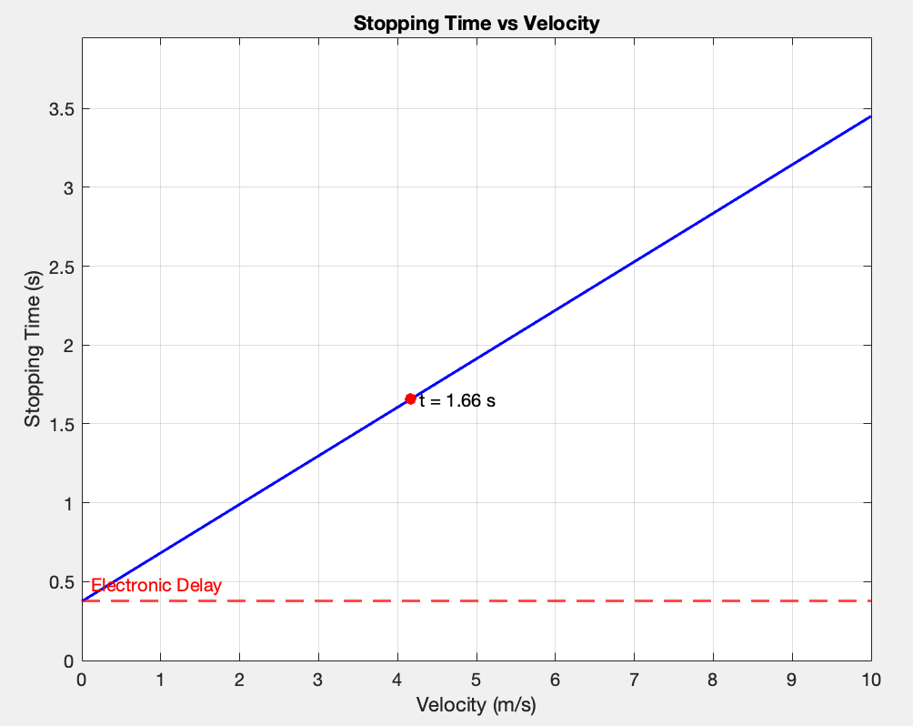
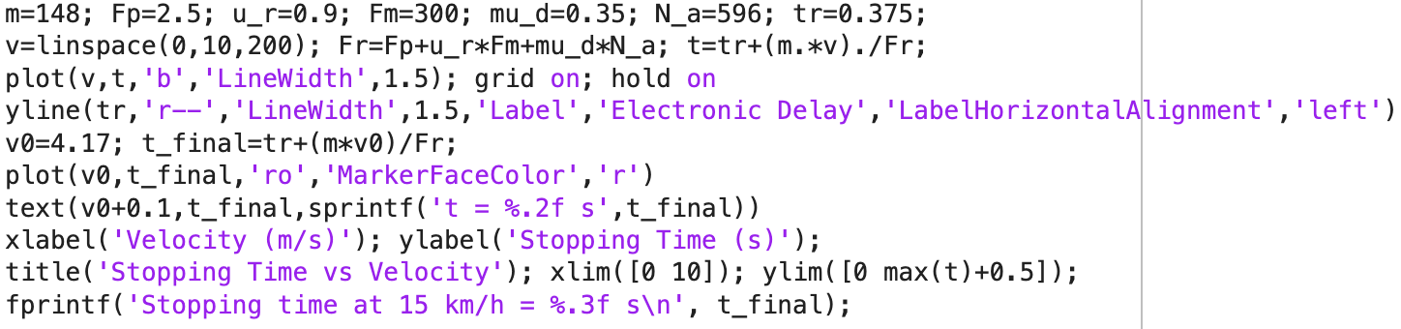
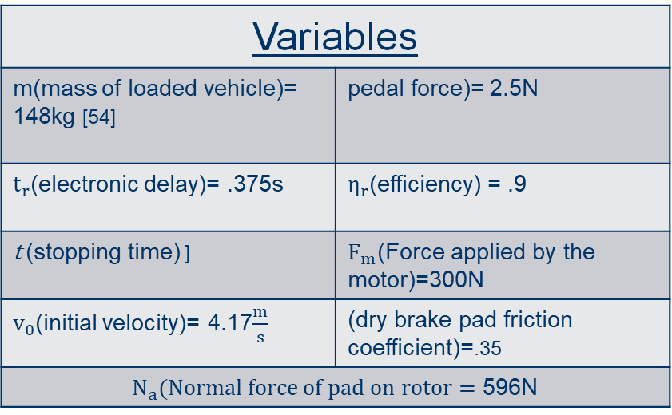
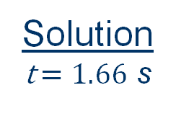
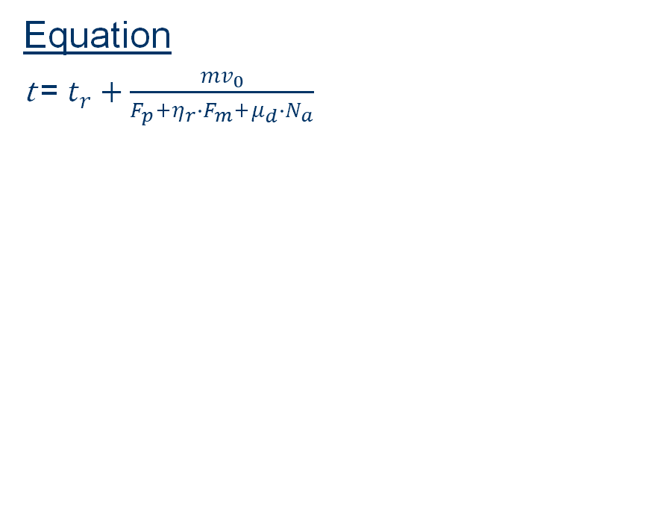
Brakes: Autonomous Vehicle Braking Time Assessment
Question: Determine the total stopping time ($t_{s})$ for an autonomous go-kart with a mass of 148 kg and initial velocity of 4.17 m/s?
Equation
t = $t_{r}+\frac{{mv}_{0}}{F_{p}+η_{r}∙F_{m}+μ_{d}∙N_{a}}$
Variables
m(mass of loaded vehicle)= 148kg [54] | pedal force)= 2.5N
$t_{r}$(electronic delay)= .375s | $η_{r}$(efficiency) = .9
t (stopping time) ] | $F_{m}$(Force applied by the motor)=300N
$v_{0}$(initial velocity)= 4.17$\frac{m}{s}$ | (dry brake pad friction coefficient)=.35
$N_{a}(Normal force of pad on rotor=$ 596N
Solution
t $=1.66$ s
JK 20

Slide 21
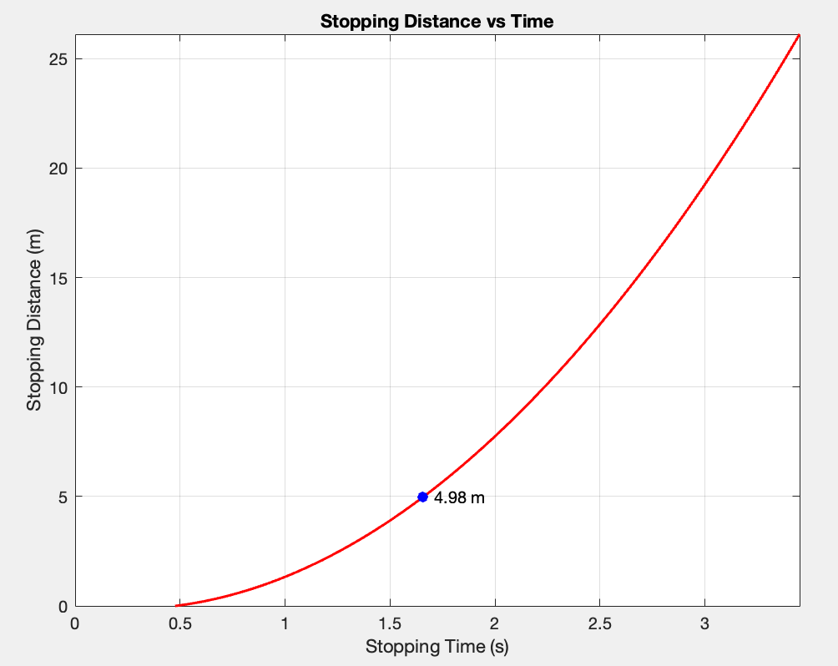
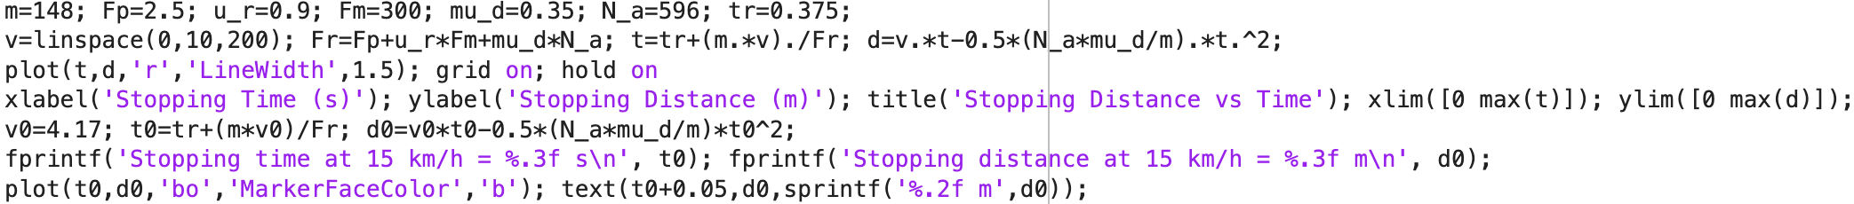
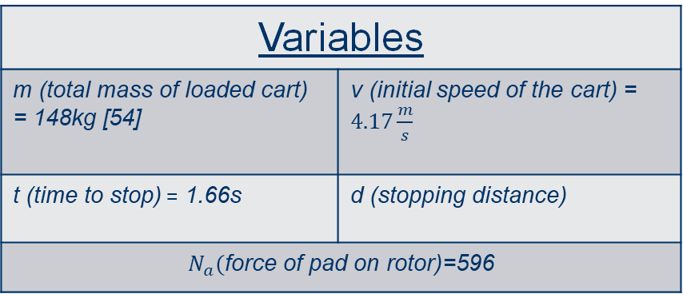
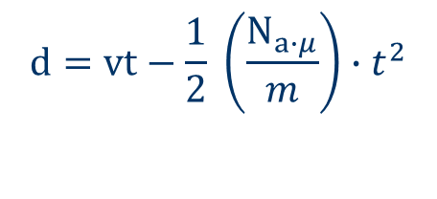
Brakes: Stopping Distance
Question: How far will a 148kg Go-Cart travel before coming to a complete stop given an initial speed of $4.17\frac{m}{s}$?
Equation
$$d=vt−\frac{1}{2} \left(\frac{N_{a∙μ}}{m}\right)∙t^{2}$$
Solution
d=4.98m
Variables
m (total mass of loaded cart) = 148kg [54] | v (initial speed of the cart) = $4.17\frac{m}{s}$
t (time to stop) = 1.66s | d (stopping distance)
$N_{a}($force of pad on rotor)=596
JK 21

Slide 22
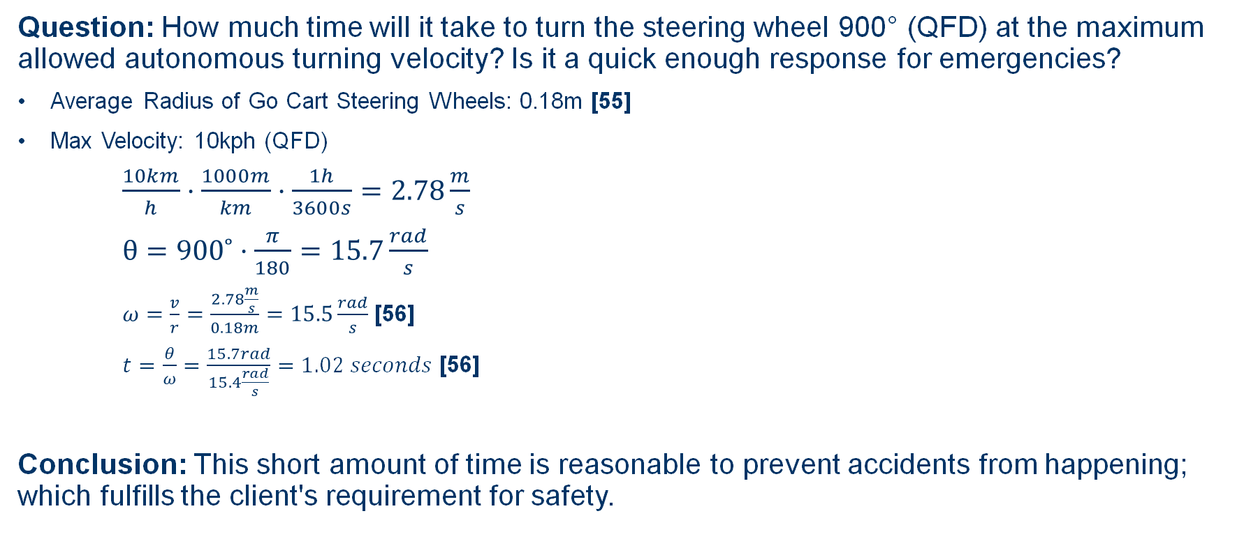
Calculations: Steering
Question: How much time will it take to turn the steering wheel 900° (QFD) at the maximum allowed autonomous turning velocity? Is it a quick enough response for emergencies?
Average Radius of Go Cart Steering Wheels: 0.18m [55]
Max Velocity: 10kph (QFD)
$\frac{10km}{h}·\frac{1000m}{km}·\frac{1h}{3600s}=2.78\frac{m}{s}$
$θ=900˚·\frac{π}{180}=15.7\frac{rad}{s}$
$ω=\frac{v}{r}=\frac{2.78\frac{m}{s}}{0.18m}=15.5\frac{rad}{s}$ [56]
$t=\frac{θ}{ω}=\frac{15.7rad}{15.4\frac{rad}{s}}=1.02 seconds$ [56]
Conclusion: This short amount of time is reasonable to prevent accidents from happening; which fulfills the client's requirement for safety.
SC 22

Slide 23
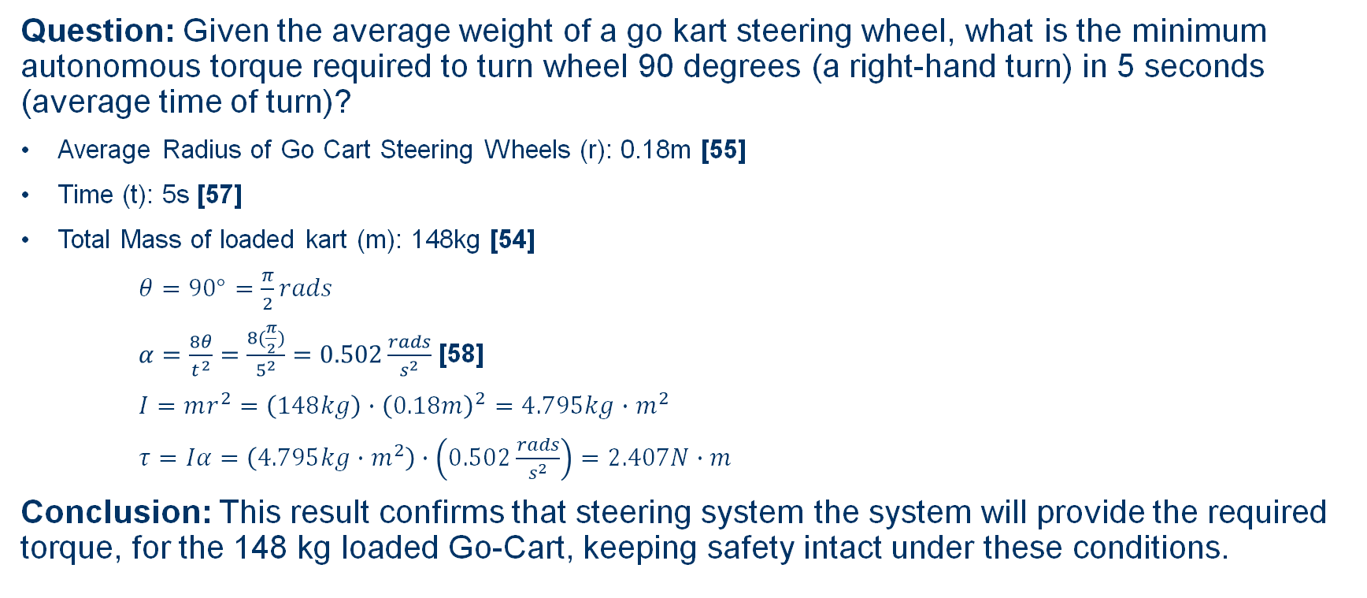
Calculations: Steering
Question: Given the average weight of a go kart steering wheel, what is the minimum autonomous torque required to turn wheel 90 degrees (a right-hand turn) in 5 seconds (average time of turn)?
Average Radius of Go Cart Steering Wheels (r): 0.18m [55]
Time (t): 5s [57]
Total Mass of loaded kart (m): 148kg [54]
$θ=90°=\frac{π}{2}rads$
$α=\frac{8θ}{t^{2}}=\frac{8(\frac{π}{2})}{5^{2}}=0.502\frac{rads}{s^{2}}$ [58]
$I=mr^{2}=\left(148kg\right)∙{\left(0.18m\right)}^{2}=4.795kg∙m^{2}$
$τ=Iα=\left(4.795kg∙m^{2}\right)∙\left(0.502\frac{rads}{s^{2}}\right)=2.407N∙m$
Conclusion: This result confirms that steering system the system will provide the required torque, for the 148 kg loaded Go-Cart, keeping safety intact under these conditions.
[54]
DM 23

Slide 24
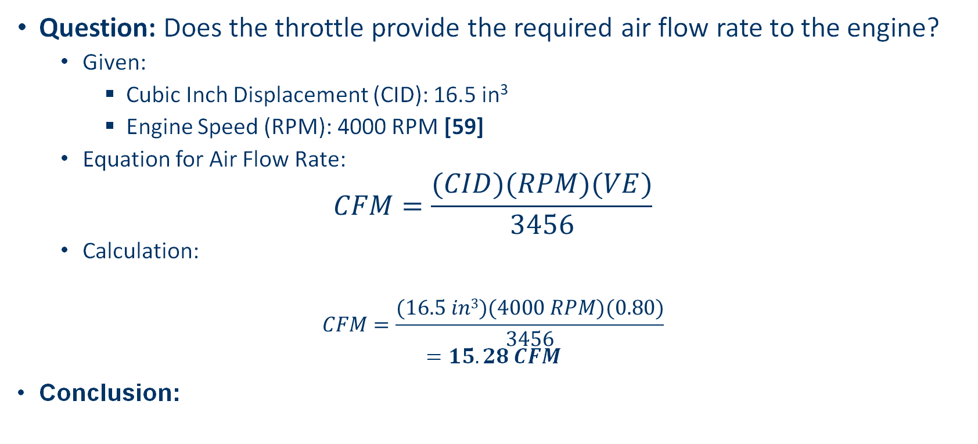
Calculations: Throttle
Question: Does the throttle provide the required air flow rate to the engine?
Given:
Cubic Inch Displacement (CID): 16.5 in³
Engine Speed (RPM): 4000 RPM [59]
Equation for Air Flow Rate:
$$CFM=\frac{(CID)(RPM)(VE)}{3456}$$
Calculation:
$$CFM=\frac{(16.5 in3)(4000 RPM)(0.80)}{3456}$$
$$=15.28 CFM$$
Conclusion:
Volumetric Efficiency (VE): 80% = 0.80
EC 24

Slide 25
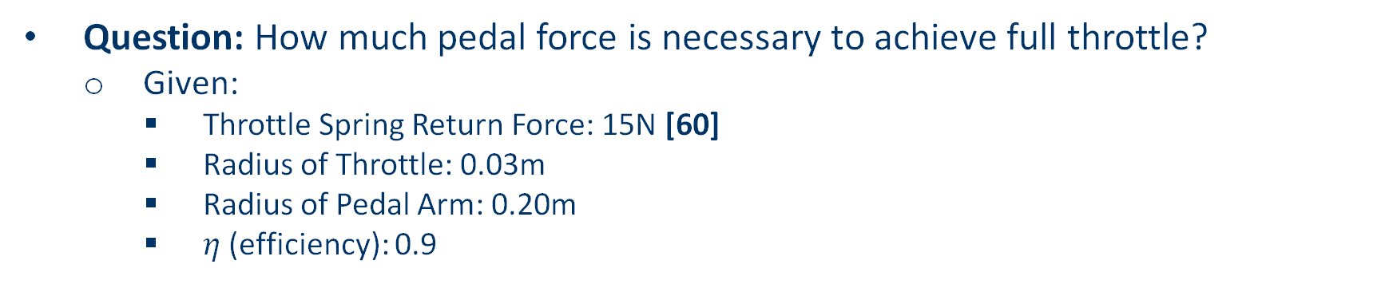
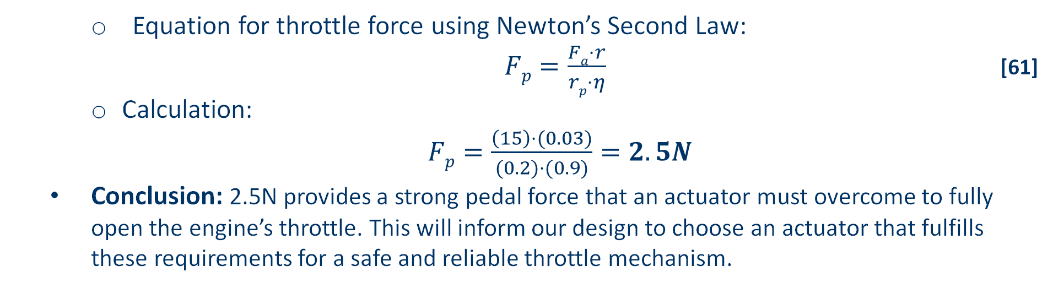
Calculations: Throttle
Question: How much pedal force is necessary to achieve full throttle?
Given:
Throttle Spring Return Force: 15N [60]
Radius of Throttle: 0.03m
Radius of Pedal Arm: 0.20m
$η$ (efficiency): 0.9
Equation for throttle force using Newton’s Second Law:
$Fp=\frac{Fa⋅r}{rp⋅η}$ [61]
Calculation:
$Fp=\frac{\left(15\right)⋅(0.03)}{(0.2)⋅(0.9)}=2.5N$
Conclusion: 2.5N provides a strong pedal force that an actuator must overcome to fully open the engine’s throttle. This will inform our design to choose an actuator that fulfills these requirements for a safe and reliable throttle mechanism.
NP 25

Slide 26
Gantt Chart - Brakes
Brake Subsystem |  | Start Date | End Date | Days | Hours |  |  | W1 | W2 | W3 | W4 | W5 | W6 | W7 | W8 | W9 | W10 | W11 | W12 | W13 | W14
Measurements on Vehicle |  | 14-Sep | 28-Sep | 14 | 6
Decide Design for Braking |  | 21-Sep | 28-Sep | 7 | 3
Prototype 1 |  | 22-Sep | 20-Oct | 28 | 14
Prototype 2 |  | 21-Oct | 10-Nov | 20 | 14
Integration with Sensors |  | 1-Nov | 1-Dec | 30 | 16
Prototype 3 |  | 11-Nov | 1-Dec | 20 | 20
ML 26

Slide 27
Gantt Chart - Steering
Steering Subsystem |  | Start Date | End Date | Days | Estimated Hours |  | W1 |  | W2 | W3 | W4 | W5 | W6 | W7 | W8 | W9 | W10 | W11 | W12 | W13 | W14
Research Options |  | 15-Sep | 25-Sep | 10 | 10
Begin Drafting Designs |  | 26-Sep | 6-Oct | 10 | 15
Budget & Purchase Materials |  | 7-Oct | 14-Oct | 7 | 10
Prototype 1 |  | 15-Oct | 30-Oct | 15 | 20
Prototype 2 |  | 31-Oct | 15-Nov | 15 | 20
Prototype 3 |  | 16-Nov | 1-Dec | 15 | 20
DM 27

Slide 28
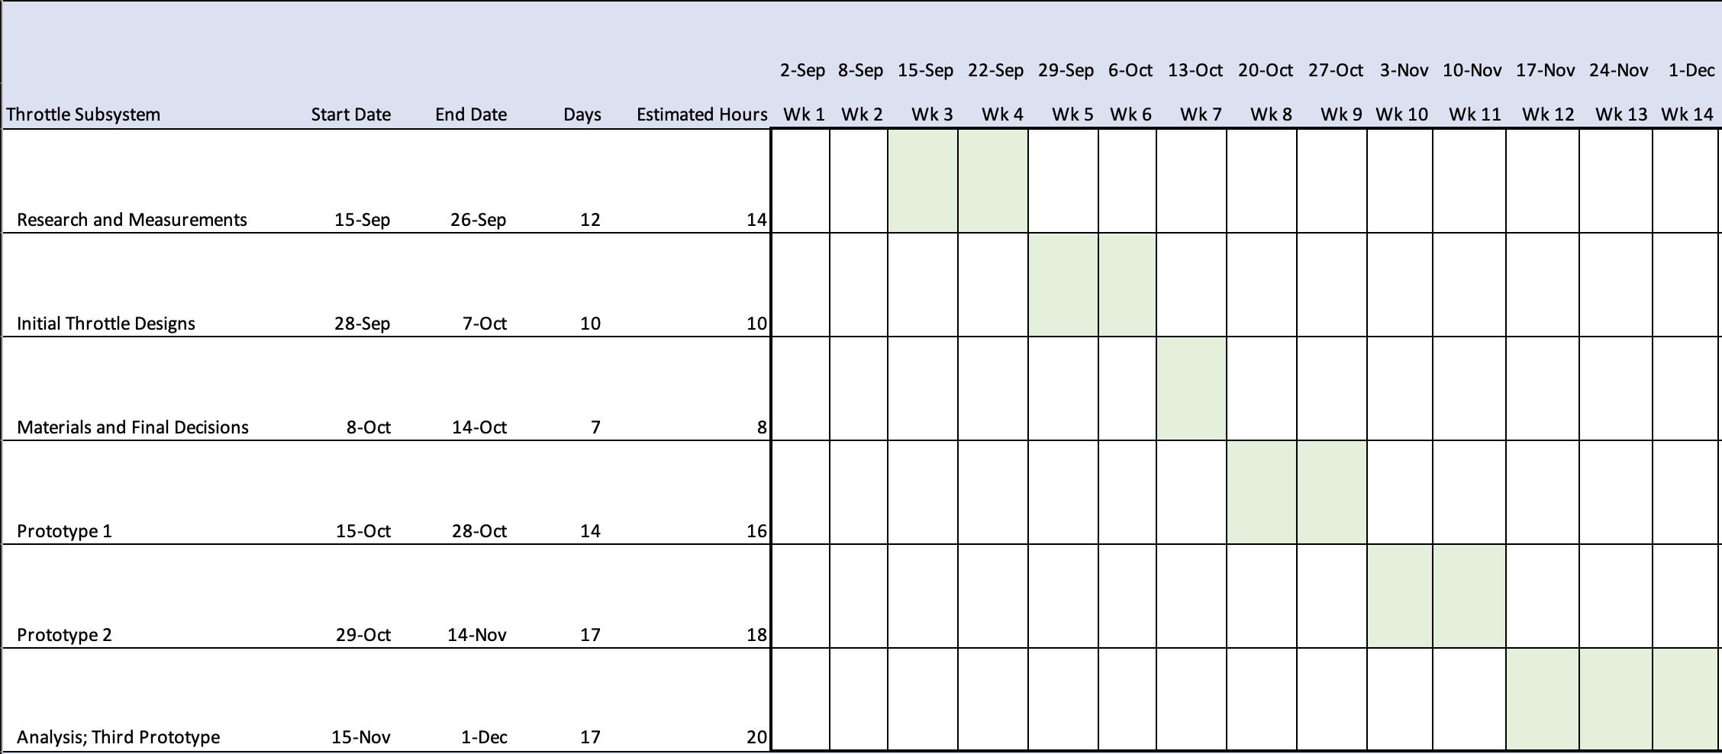
Gantt Chart - Throttle
NP 28

Slide 29
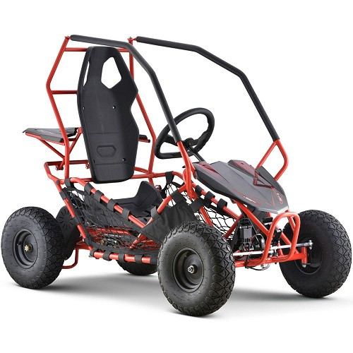

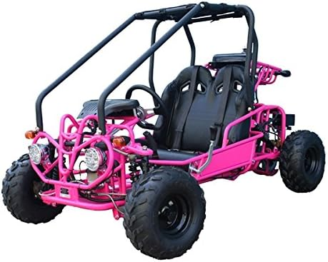
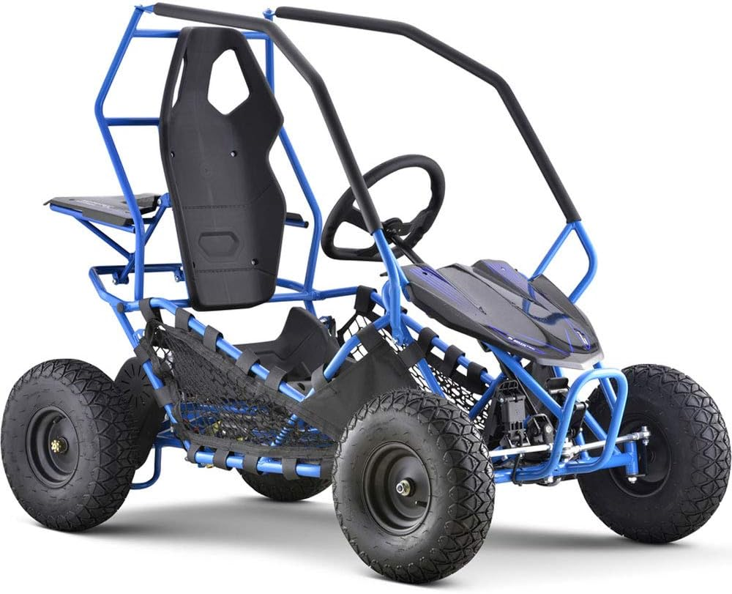
Schedule and Future Work
Potential Go Kart #1 [62]
Overview
Very generalized tentative schedule
Estimated days and hours
Subject to change
Future Work
Buying our Kart
Boeing Meeting 2
CAD Work
Fundraising
Prototype 1
Website Design
Potential Go Kart #2 [62]
Potential Go Kart #3 [63]
ML 29
Notes:
I figured Gantt chart was good for presenting the schedule but it does not fit very well

Slide 30
Budget
$5000 acquired from Boeing
$500 is minimum goal for fundraising though our goal is $1600-$5000 on GoFundMe
3-5% per Sub-Team for each Prototype
20% for Prototype 1…………………………………………………………………………….....$1100
20% for Prototype 2……………………………………………………..…………………...…....$1100
20% for Prototype 3……………………………………………..…………………..……..…......$1100
25% for Vehicle……………………………..………………..…………………………………….…$1375
6.5% for Transportation…………………………………………………..………………..……..$350
8.5% Undecided/Semester 2……………………………………….......………………….....$468
ML 30
Notes:
In last class Willy mentioned 15% per prototype so 30% so I’m not sure we’re supposed to have 3 prototypes. In the Gantt I put prototype 3 as prototype 2 due date and same scale down with prototype 2 to 1’s due date. I imagine our “prototype 1” will be more of a proof of concept and not a functioning prototype. Budget will also need to be adjusted.

Slide 31
Electrical Engineers
Meet the Team
Work Needed
Dante Palmieri
Devon Allan
Evan Hudak
Seth Jones
Sensor Integration
Wiring
Programming
Control System
Kill Switch
ML 31

Slide 32
Thank you!

Slide 33
Works Cited
[1] https://altcalculator.com/stopping-distance-calculator-aashto-standard/
[2] H. Tamm, “Boeing forecast: emerging markets to drive demand for commercial aircraft over next 20 years,” AviTrader Aviation News, Jun. 16, 2025. https://avitrader.com/2025/06/16/boeing-forecast-emerging-markets-to-drive-demand-for-commercial-aircraft-over-next-20-years/
[3] “Odenwaldpokal,” Facebook.com, 2022. https://www.facebook.com/Odenwaldpokal/posts/beule-pr%C3%A4sentiert-seine-updatesheute-war-es-soweit-joachim-beule-kam-heute-nach-/1019458385062881/ (accessed Sep. 16, 2025).
[4] “Go Kart Throttle Cable: Parts Kit & Setup - KartFab.com,” KartFab.com, Feb. 02, 2019. https://kartfab.com/go-kart-plans/go-kart-throttle-cable (accessed Sep. 17, 2025).
[5] “Redirect Notice,” Google.com, 2025. https://www.google.com/url?sa=i&url=https%3A%2F%2Fwww.epicwheelz.com%2Fproducts%2Ftrailmaster-mid-xrx-2-seater-go-kart&psig=AOvVaw0O-b64v9u1_ogkhpY3YeOJ&ust=1758213881109000&source=images&cd=vfe&opi=89978449&ved=0CBcQjhxqFwoTCOjQsOuf4I8DFQAAAAAdAAAAABAD (accessed Sep. 17, 2025).
[6] Caltech, “How Does AI Drive Autonomous Systems?,” Caltech Science Exchange. https://scienceexchange.caltech.edu/topics/artificial-intelligence-research/autonomous-ai-cars-drones
[7] “Redirect Notice,” Google.com, 2025. https://www.google.com/url?sa=i&url=https%3A%2F%2Fwww.peakpx.com%2Fen%2Fhd-wallpaper-desktop-pdpma&psig=AOvVaw0DxnxktQvaBv9sPMrurDeN&ust=1758215901073000&source=images&cd=vfe&opi=89978449&ved=0CBkQjhxqFwoTCMD0tuSm4I8DFQAAAAAdAAAAABAE (accessed Sep. 17, 2025).
[8] N. Gagliordi, “Waymo, Jaguar Land Rover form autonomous driving partnership,” ZDNET, Mar. 27, 2018. https://www.zdnet.com/article/waymo-jaguar-land-rover-form-autonomous-driving-partnership/ (accessed Sep. 17, 2025).
[9] A. Priddle, “Meet the Cruise AV, GM’s First Production-Ready Driverless Car,” MotorTrend, Jan. 12, 2018. https://www.motortrend.com/news/meet-cruise-av-gms-first-production-ready-driverless-car (accessed Sep. 17, 2025).
[10] S. G. Shadle, L. H. Emery, and H. K. Brewer, “Vehicle Braking, Stability and Control,” Login - CAS – central authentication service, https://www-jstor-org.libproxy.nau.edu/stable/44668097?seq=6 (accessed Sep. 14, 2025).

Slide 34
Works Cited
[11] D. L. Jindrich, T. F. Besier, and D. G. Lloyd, “A hypothesis for the function of braking forces during running turns,” Journal of Biomechanics, vol. 39, no. 9, pp. 1611–1620, May 2005. doi:10.1016/j.jbiomech.2005.05.007
[12] K. D. Marshall, R. L. Phelps, M. G. Pottinger, and W. Pelz, “The effect of tire break-in on force and moment properties,” SAE Technical Paper Series, Feb. 1977. doi:10.4271/770870
[13] F. Talati and S. Jalalifar, “Analysis of heat conduction in a disk brake system,” Heat and Mass Transfer, vol. 45, no. 8, pp. 1047–1059, Jan. 2009. doi:10.1007/s00231-009-0476-y
[14] M. Haataja and T. Leinonen, “On the distribution of braking forces in road braking,” SAE Technical Paper Series, Dec. 2000. doi:10.4271/2000-01-3413
[15] P. S. Bokare and A. K. Maurya, “Acceleration-deceleration behaviour of various vehicle types,” Transportation Research Procedia, vol. 25, pp. 4733–4749, 2017. doi:10.1016/j.trpro.2017.05.486
[16] “Autonomous Vehicles Testing and operating in the state of Arizona,” Autonomous Vehicles Testing and Operating in the State of Arizona | Department of Transportation, https://azdot.gov/mvd/services/professional-services/autonomous-vehicles-testing-and-operating-state-arizona (accessed Sep. 17, 2025).
[17] K. Bimbraw, “Autonomous Cars: Past, Present and Future — A Review of the Developments in the Last Century, the Present Scenario and the Expected Future of Autonomous Vehicle Technology,” in Proc. 12th International Conference on Informatics in Control, Automation and Robotics (ICINCO 2015), Vol. 1, Patiala, India, Jul. 2015, pp. 191-198. doi:10.5220/000554050191019
[18] T. D. Gillespie, Fundamentals of Vehicle Dynamics. Warrendale, PA: SAE International
[19] M. Sabri and A. Fauza, “Analysis of vehicle braking behaviour and distance stopping,” IOP Conference Series: Materials Science and Engineering, vol. 309, 2018, Art. no. 012020.
[20] M. H. M. Basri, A. H. Zulkifli, N. I. Ismail, T. R. Jaafar, M. A. A. H. Pahmi, and A. Husin, “Conceptual Design Evaluation of Concurrent Brake Actuator Mechanism,” Journal ofApplied Engineering Design and Simulation, vol. 1, no. 1, 2021, pp. 97–105, doi: 10.24191/jaeds.v1i1.29.

Slide 35
Works Cited
[21] A. Hac, “Effects of Brake Actuator Error on Vehicle Dynamics and Stability,” SAE Technical Paper 2005-01-1578, SAE Mobilus, 2005, doi: 10.4271/2005-01-1578
[22] D. Liu, W. Huang, R. Chu, Z. Li, X. Jin, H. Zhang, Y. Wang, and S. Ji, “Study on Performance Testing and Evaluation of Autonomous Emergency Braking System Based on Self-Constructed Comprehensive Performance Evaluation Index Model,” Sensors, vol. 25, no. 7, MDPI, 2025, doi: 10.3390/s25072171
[23] M. H. Hwang, G. S. Lee, E. Kim, H. W. Kim, S. Yoon, T. Talluri, and H. R. Cha, “Regenerative Braking Control Strategy Based on AI Algorithm to Improve Driving Comfort of Autonomous Vehicles,” Applied Sciences, vol. 13, no. 2, MDPI, 2023, doi: 10.3390/app13020946
[24] B. Mok, M. Johns, S. Yang, and W. Ju, “Reinventing the Wheel,” Oct. 2017, doi: https://doi.org/10.1145/3126594.3126655.
[25] W. Kim, C. Kang, Y.-S. Son, and C. Chung, “Nonlinear Steering Wheel Angle Control Using Self-Aligning Torque with Torque and Angle Sensors for Electrical Power Steering of Lateral Control System in Autonomous Vehicles,” Sensors, vol. 18, no. 12, p. 4384, Dec. 2018, doi: https://doi.org/10.3390/s18124384.
[26] J. E. Naranjo, C. González, R. García, and T. de Pedro, “Electric Power Steering Automation for Autonomous Driving,” Lecture Notes in Computer Science, pp. 519–524, 2005, doi: https://doi.org/10.1007/11556985_67.
[27] P. Falcone, F. Borrelli, J. Asgari, H. E. Tseng, and D. Hrovat, “Predictive Active Steering Control for Autonomous Vehicle Systems,” IEEE Transactions on Control Systems Technology, vol. 15, no. 3, pp. 566–580, May 2007, doi: https://doi.org/10.1109/tcst.2007.894653.
[28] M. K. Mishra, A. Maurya, and R. R. Dev, “Automatic Steering System,” International Journal of Science and Research (IJSR), vol. 5, no. 5, pp. 105–107, May 2016, doi: 10.21275/NOV163265
[29] Z. M. U. Din, W. Razzaq, U. Arif, W. Ahmad, and W. Muhammad, “Real Time Ackerman Steering Angle Control for Self-Driving Car Autonomous Navigation,” 2019 4th International Conference on Emerging Trends in Engineering, Sciences and Technology (ICEEST), pp. 1–4, Dec. 2019, doi: https://doi.org/10.1109/iceest48626.2019.8981710.
[30] “The Motor Carrier Safety Planner,” Dot.gov, 2025. https://csa.fmcsa.dot.gov/safetyplanner/MyFiles/SubSections.aspx?ch=22&sec=64&sub=141 (accessed Sep. 17, 2025).
[31] M. J. Lewis, “STEERING SYSTEM AND METHOD FOR AUTONOMUS VEHICLES,” Mar. 2022 STEERING SYSTEM AND METHOD FOR AUTONOMUS VEHICLES - EuropeanPatent Office - EP 3283349 B1

Slide 36
Works Cited
[32] “Intelligent Electric Power Steering: Artificial Intelligence Integration Enhances Vehicle Safety and Performance,” Intelligent Electric Power Steering: Artificial Intelligence IntegrationEnhances Vehicle Safety and performance, https://arxiv.org/html/2412.08133v1 (accessed Sep. 14, 2025). Intelligent Electric Power Steering: Artificial Intelligence IntegrationEnhances Vehicle Safety and Performance
[33] B. Németh, D. Fényes, P. Gáspár and A. Mihály, "Analysis and robust control design of a steering system forautonomous vehicles," 2017 IEEE International Conference on Advanced Intelligent Mechatronics (AIM), Munich,Germany, 2017, pp. 535-540, doi: 10.1109/AIM.2017.8014072. keywords: {Vehicle dynamics;Steeringsystems;Frequency-domain analysis;Tires;Autonomous vehicles;Control design}, Analysis and robust control design ofa steering system for autonomous vehicles | IEEE Conference Publication | IEEE Xplore
[34] H. Halin et al., "Simulation Studies - Path Tracking of an Autonomous Electric Vehicle (AEV) by Using FuzzyInformation of Speed and Steering Angle," 2018 International Conference on Computational Approach in SmartSystems Design and Applications (ICASSDA), Kuching, Malaysia, 2018, pp. 1-4, doi: 10.1109/ICASSDA.2018.8477593.keywords: {Autonomous vehicles;Navigation;Wheels;Mechatronics;Reliability;Automobiles;Inputvariables;fuzzy;simulation;lateral error;autonomous;steering control}, Simulation Studies - Path Tracking of anAutonomous Electric Vehicle (AEV) by Using Fuzzy Information of Speed and Steering Angle | IEEE ConferencePublication | IEEE Xplore
[35] Y. Jeong, D. H. Kim, M. H. Youn, S. Park, X. J. Li and T. Lee, "Model Predictive Control-Based Path Tracking withFour-Wheel Independent Steering, Driving, and Braking Autonomous Vehicles on Low Friction Road," 2023 23rdInternational Conference on Control, Automation and Systems (ICCAS), Yeosu, Korea, Republic of, 2023, pp. 1427-1432, doi: 10.23919/ICCAS59377.2023.10316779. keywords: {Transmission line matrixmethods;Friction;Roads;Wheels;Predictive models;Tires;Robustness;Autonomous vehicle;Four-wheel independentsteering;Four-wheel independent driving;Four-wheel independent braking;Low friction road. Model predictivecontrol;Control allocation}, Model Predictive Control-Based Path Tracking with Four-Wheel Independent Steering,Driving, and Braking Autonomous Vehicles on Low Friction Road | IEEE Conference Publication | IEEE Xplore
[36] A. Pushpakanth and M. N. Dhavalikar, Development of Steering Control System for Autonomous Vehicle,https://www.ijrte.org/wp-content/uploads/papers/v11i2/B71050711222.pdf (accessed Sep. 15, 2025). Development ofSteering Control System for Autonomous Vehicle
[37] TheRacingXpert, “ What Is The Role Of Steering Angle Sensor In Autonomous Driving?,”YouTube,https://youtu.be/bUD_fHQGjMk?si=sNnU_rH6ueBvyz2l (accessed Sep. 14, 2025).
[38] N. H. T. S. A. part of the U.S. Department of Transportation, “Automated vehicles for safety,” NHTSA, https://www.nhtsa.gov/vehicle-safety/automated-vehicles-safety (accessed Sep. 17, 2025).
[39] “Throttle Body Optimization for Autonomous Decision-Making Systems,” Patsnp Eureka, 2025. https://eureka.patsnap.com/report-throttle-body-optimization-for-autonomous-decision-making-systems (accessed Sep. 15, 2025).

Slide 37
Works Cited
[40] Ardhana Putra Setyawan, Dedid Cahya Happyanto, and None Alrijadjis, “Implementation of Intelligent Speed Control for Autonomous Electric Vehicles,” 2022 International Electronics Symposium (IES), pp. 58–63, Aug. 2023, doi: https://doi.org/10.1109/ies59143.2023.10242563.
[41] A. Shaout and M. A. Jarrah, “Cruise control technology review,” Computers & Electrical Engineering, vol. 23, no. 4, pp. 259–271, Jul. 1997, doi: https://doi.org/10.1016/s0045-7906(97)00013-x.
[42] J. F. Arango et al., “Drive-By-Wire Development Process Based on ROS for an Autonomous Electric Vehicle,” Sensors, vol. 20, no. 21, p. 6121, Oct. 2020, doi: https://doi.org/10.3390/s20216121.
[43] D. Coffin, S. Oliver, and J. VerWey, “Building Vehicle Autonomy: Sensors, Semiconductors, Software and U.S. Competitiveness,” SSRN Electronic Journal, 2019, doi: https://doi.org/10.2139/ssrn.3492778.
[44] V. S. Dubey, Ruhshad Kasad, and K. Agrawal, “Autonomous Braking and Throttle System: A Deep Reinforcement Learning Approach for Naturalistic Driving,” arXiv (Cornell University), Jan. 2021, doi: https://doi.org/10.5220/0010157401730180.
[45] G. Lavanya, M. Deva Priya, A. Balamurugan, and C. Jeba, “An adaptive throttle and brake control system for automatic cruise control in disability support vehicle,” Proceedings of the 4th International Conference on Smart City Applications, Oct. 2019, doi: https://doi.org/10.1145/3368756.3369045.
[46] Tigadi, A. S., Changappa, N., Singhal, S., & Kulkarni, S. (2021, April 4). Autonomous vehicles: Present technological traits and scope for future innovation. SpringerLink. https://link.springer.com/chapter/10.1007/978-3-030-59897-6_7
[47] Peng Hang, X. X. (2022, March 17). Actuators for intelligent electric vehicles. MDPI Books. https://doi.org/10.3390/books978-3-0365-3511-1
[48] You, H.-W., Ko, M.-J., Lin, Y.-C., Zhao, J.-Y., & Chen, Y.-J. (2024). Smooth Speed Control for an autonomous vehicle and on-road verification. 2024 IEEE SENSORS, 1–4. https://doi.org/10.1109/sensors60989.2024.10785102
[49] Blanco, M., Chaka, M., Stowe, L., Gabler, H. C., Weinstein, K., Gibbons, R. B., … Fitchett, V. L. (2020, April). FMVSS considerations for vehicles with automated driving systems: Volume 1 (Report No. DOT HS 812 796). National Highway Traffic Safety Administration.
[50] Yin, S., Yang, C., Kawsar, I., Du, H., & Pan, Y. (2022). Longitudinal Predictive Control for Vehicle-Following Collision Avoidance in Autonomous Driving Considering Distance and Acceleration Compensation. Sensors (Basel, Switzerland), 22(19), 7395. https://doi.org/10.3390/s22197395

Slide 38
Works Cited
[51] Wang, J., Pun, A., Tu, J., Manivasagam, S., Sadat, A., Casas, S., Ren, M., & Urtasun, R. (2021). AdvSim: Generating Safety-Critical Scenarios for Self-Driving Vehicles. Proceedings (IEEE Computer Society Conference on Computer Vision and Pattern Recognition. Online), 9904–9913. https://doi.org/10.1109/CVPR46437.2021.00978
[52] Mattikalli, S., Rayar, V., Yallure, B., Akki, S., & Thane, S. (2024). AUTOSAR-enabled throttle position sensor testing and analysis using MATLAB. 2024 IEEE North Karnataka Subsection Flagship International Conference (NKCon), 1–5. https://doi.org/10.1109/nkcon62728.2024.10775293
[53]
[54] des dreckett, “How Much Does a Racing Go-Kart Weigh? (UPDATED 2025),” RiiRoo, Aug. 04, 2023. https://riiroo.com/blogs/ride-on-toy-guides/how-much-does-a-racing-go-kart-weigh?srsltid=AfmBOoq8dmP2ezMRMQtydwRUoUYJ6jsrluS_NX0Evc3fU-7l8qRzr6ve (accessed Sep. 18, 2025).
[55] “How To Choose A Kart Steering Wheel - Aim Technologies,” Aim Technologies, Mar. 24, 2025. https://www.aimtechnologies.com/how-to-choose-kart-steering-wheel/
[56] Lumen Learning, “Rotation Angle and Angular Velocity | Physics,” courses.lumenlearning.com. https://courses.lumenlearning.com/suny-physics/chapter/6-1-rotation-angle-and-angular-velocity/
[57] “What speed should you make a right turn?,” Learn Automatic, https://www.learn-automatic.com/tutorials/right-turns-in-automatic-car/speed/ (accessed Sep. 16, 2025).
[58] “Autonomous Torque Calculation,” ChatGPT, https://chatgpt.com/s/t_68c9a011cb688191b759f1cd35489e71 (accessed Sep. 16, 2025).
[59] K. Vinith and P. Sathiamurthi, “Design And Fabrication Of Adaptive Spoiler For Go -Kart Vehicles,” 2044. Accessed: Sep. 15, 2025. [Online]. Available: https://www.ijstr.org/final-print/mar2020/Design-And-Fabrication-Of-Adaptive-Spoiler-For-Go-Kart-Vehicles.pdf
[60] GmbH, R. B. (2014). Automotive Handbook, 9th edition. John Wiley & Sons.
[61] Hang, P., Xia, X., & Chen, X. (Eds.). (2022b). Actuators for Intelligent Electric Vehicles. https://doi.org/10.3390/books978-3-0365-3511-1
[62] “MotoTec Maverick Go Kart 36v 1000w Red-MT-GK-Maverick-1000w_,” MotoTec USA, 2025. https://mototecusa.com/mototec-maverick-go-kart-36v-1000w-red.html?srsltid=AfmBOopFsndbSnCM9fEoATDctOQhMEFDCPzX75qQ5rVPK3E8wcFpTcIFTds (accessed Sep. 17, 2025).
[63] “Amazon.com: 125cc Gokart Gk110 Kandi Mini Raptor 125cc Kart Gokart with Reverse and Big 16 inches Wheels for Gas Go Kart Kids and Youth (Pink) : Automotive,” Amazon.com, 2025. http://amazon.com/Upgraded-Gokart-GK110-Reverse-Wheels/dp/B015P3K9RK (accessed Sep. 17, 2025).

